Slide 1

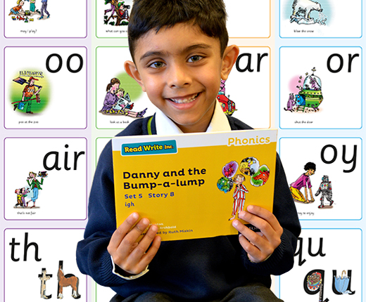
Welcome to Read Write Inc

Slide 2
Language to use:
Magnetic/ magnet eyes: children’s eyes should all be on you.
MTYT- My turn your turn
FF- Fast finger first
HAT- Have a think
TTYP- Talk to your partner
Fred Talk – segment the word

Slide 3
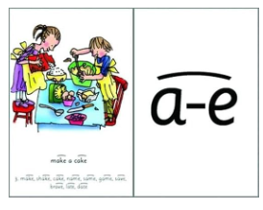

Speed sound….
Children to read the words to match from word time words

Slide 4
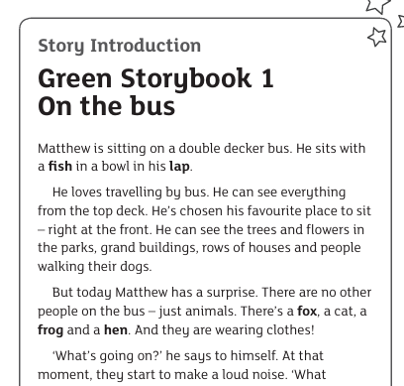
Story Introduction…..

Slide 5
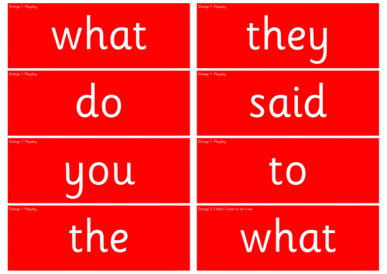
Red word time….

Slide 6
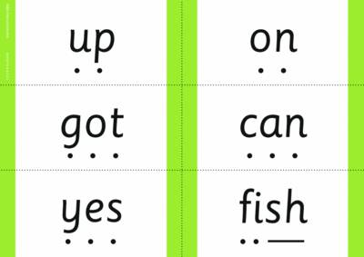
Speedy green words ….

Slide 7
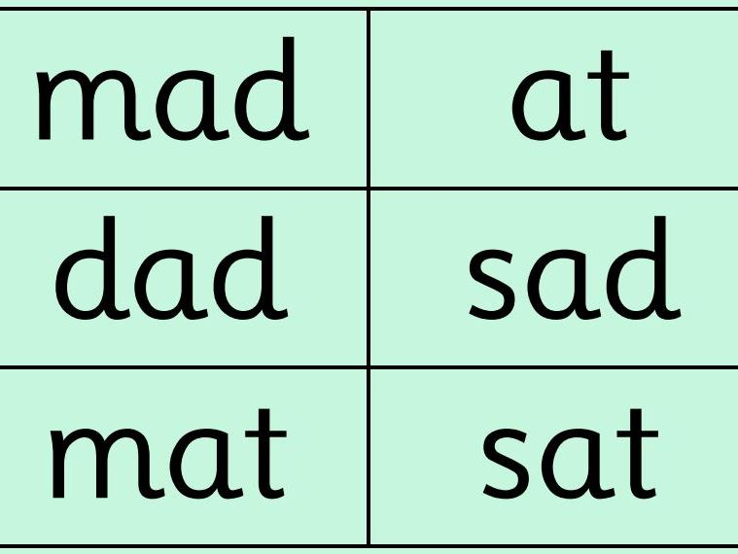
Story green words MTYT

Slide 8

Children read the story book….

Slide 9

Teacher read of the book…
Use story teller voice, intonation and expression to bring the story to life.

Slide 10
Hold a sentence…
Choose a sentence from the story for the children to hear verbally from you and then they need to remember it. They will then write it.

